Slide 1

Glycosylation of LAMP2A: Structural and Functional Insights
GEETANSHI
SNU ID:-2110111229
Under the supervision of
Dr . Nidhi Malhotra
Department of Chemistry
School of Natural Sciences

Slide 2
INTRODUCTION
ORIGIN OF PROBLEM
ROLE OF GLYCOSYLATION
TABLE OF CONTENT
OBJECTIVES
RESULTS
CONCLUSION
FUTURE ASPECTS
2

Slide 3
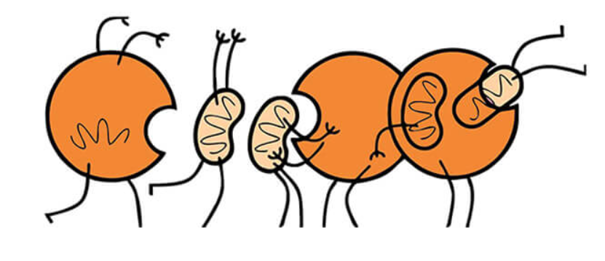

INTRODUCTION
INTRODUCTION
What is Autophagy?
Autophagy is a cellular process that degrades and recycles damaged or unnecessary components.
Types of
Autophagy
Macroautophagy
Microautophagy
Chaperone-mediated Autophagy (CMA)
Self
Eating
Selective Degradation
National Academy of Sciences 2017, 114 (2), 201–205
3

Slide 4
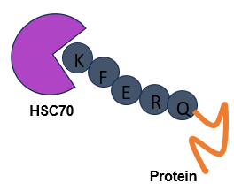

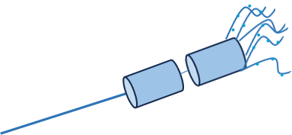
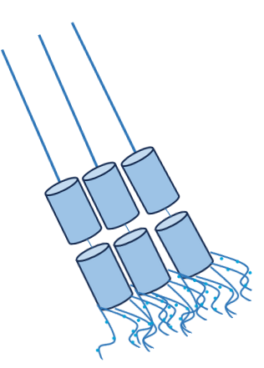



Chaperone Mediated Autophagy
MECHANISM OF CMA
K
F
E
R
Q
Protein
4
Protein Translocation
HSC70
3
Multimerization
K
F
E
R
HSC70
Q
5
Protein Degradation
Protein
1
KFERQ-like motif recognition by HSC 70
2
Recruitment of complex
Lysosome
Int J Biochem Cell Biol 2004, 36 (12), 2435–2444
4

Slide 5
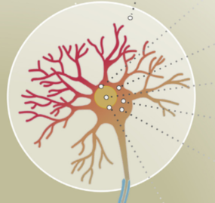
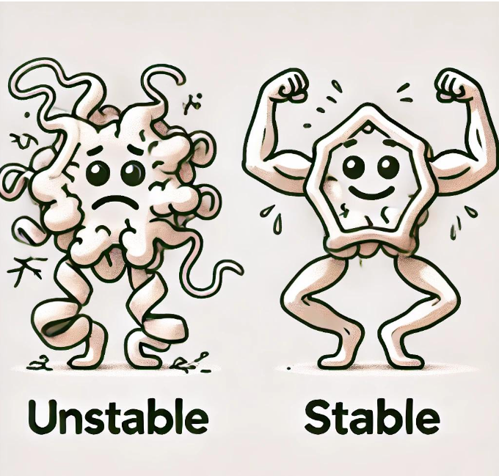
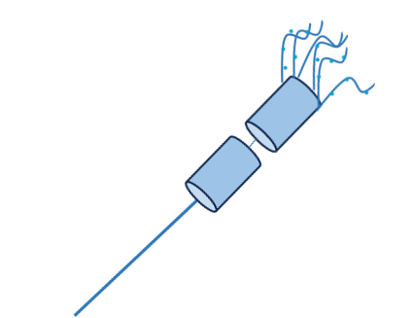
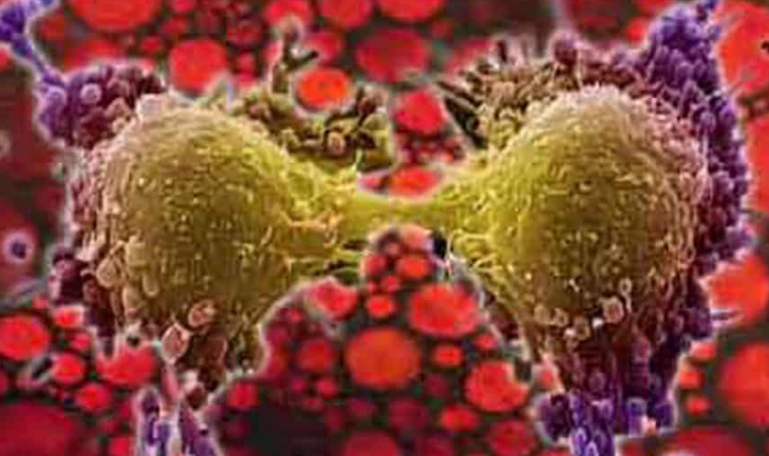
CMA significance
Essential for maintaining protein quality control and Dysregulation of CMA is linked to diseases such as neurodegeneration, cancer, and aging.
Knowledge Gaps in Structure and Dynamics
Structure Unknown
Dynamics Unexplored
Role of glycosylation
Glycosylation likely stabilizes LAMP-2A and affects its interactions and function
The exact mechanism and its impact on CMA efficiency remain poorly understood
LAMP-2A is a critical receptor in CMA, mediating substrate translocation into lysosomes.
ORIGIN OF PROBLEM
ORIGIN OF PROBLEM
?
Glycoconj J 2021, 38 , 625-647
5

Slide 6
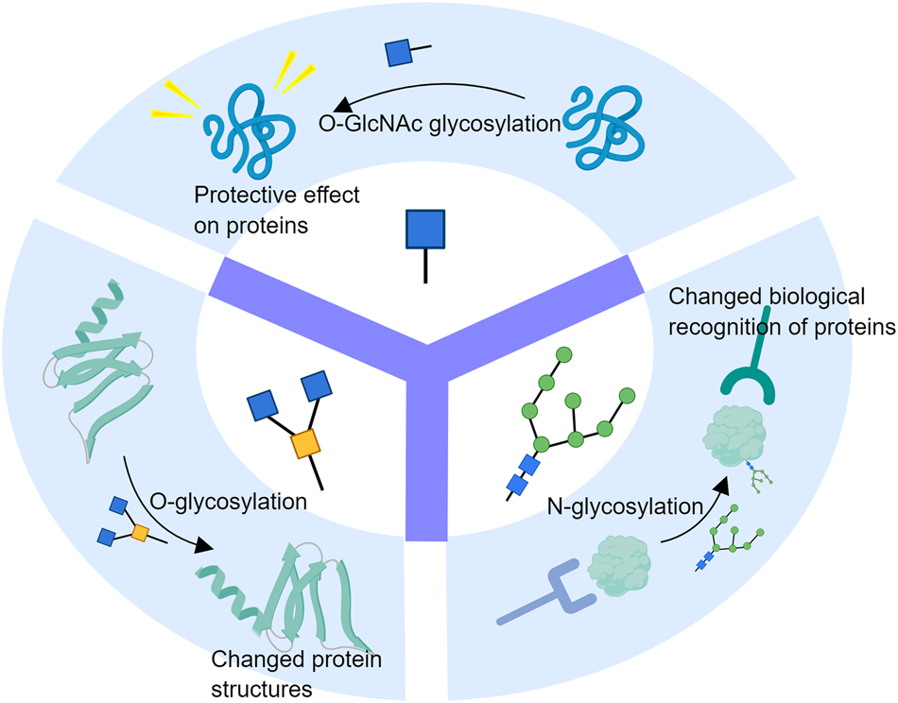
TYPES AND IMPORTANCE OF GLYCOSYLATION
Role of Glycosylation
Glycosylation is a biochemical process in which a carbohydrate molecule, such as a sugar or oligosaccharide, is covalently attached to a protein or lipid.
Glycosylation
N-Glycan
O-Glycan
D-mannose
D-galactose
N-acetyl-D-glucosamine
N-acetyl-D-galactosamine
N-acetyl-D-neuraminic acid
Cell Death Discov. 2023, 9 , 314
6

Slide 7
OBJECTIVES
Objective 1
Objective 2
Dynamics Analysis:
Understand the conformational changes of LAMP 2A
Objective 3
Effect of Glycosylation:
Investigate how glycosylation affects structural stability, interaction, and function.
Accurately model full length LAMP2A, including its glycosylated forms.
Structure modeling of glycosylated LAMP2A in realistic lysosomal membrane environment
7

Slide 8

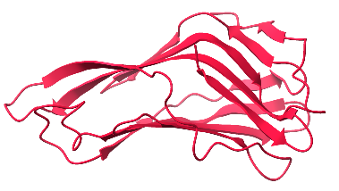
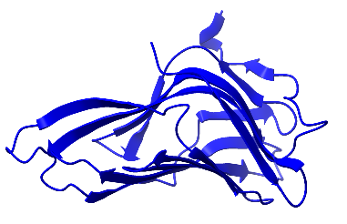
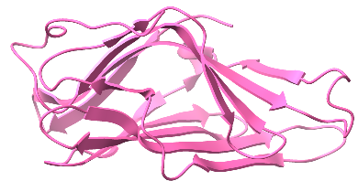
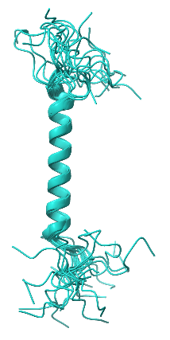
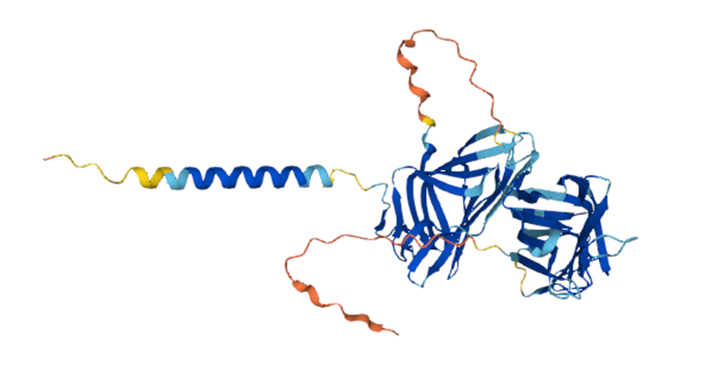
STRUCTURAL INFORMATION OF LAMP2A
Domain Architecture:
S-S
S-S
S-S
S-S
S-S
N-linked glycosylation
O-linked glycosylation
Resolved in mouse
(PDB:5GV3)
Resolved in mouse (PDB:5GV0)
and in Humans(PDB:4AKM)
Resolved in Human
(PDB:2MOF and 2MOM)
Disulfide bond
(5GV3)
(2MOF)
(5GVO)
(4AKM)
Alpha Fold Structure
Nucleic Acids Research 2024, 52 , 368-375
8

Slide 9
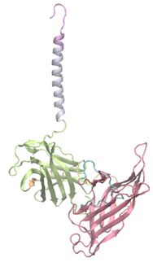
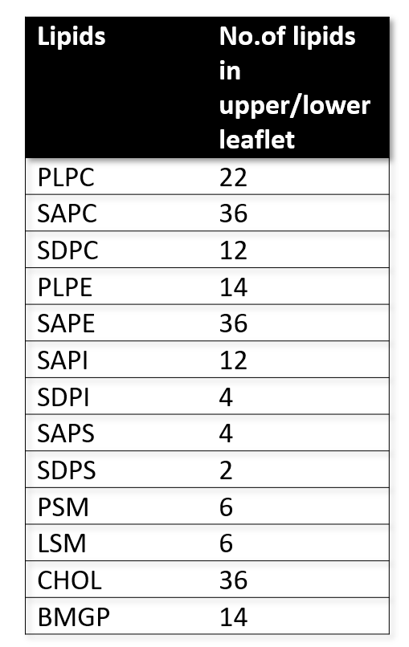
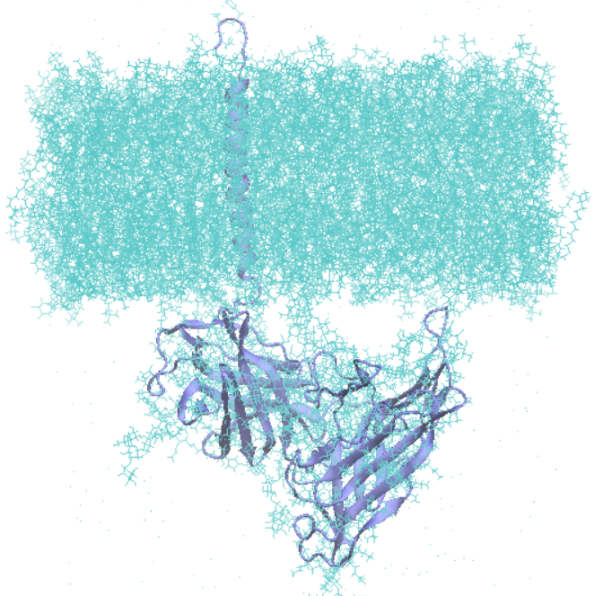
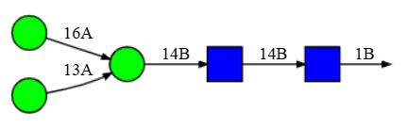
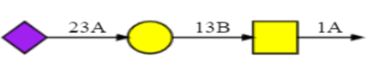
COMPUTATIONAL APPROACHES
Alpha Fold Structure
Loop Refining (Modeller)
Assigning Charges
Cytosol
pH=7
Lumen
pH=5
Adding Glycan (CHARMM GUI)
Membrane Composition
Protein Insertion in Membrane
Molecular
Dynmics
Simulation
N-Glycan
O-glycan
Analysis
9

Slide 10



ANALYSIS
Analysis
RMSD
RMSF
Radius of Gyration
Protein-Protein contacts
Membrane density
Intra Protein-Protein contact
Protein-Lipid Contact
Membrane Density
10

Slide 11
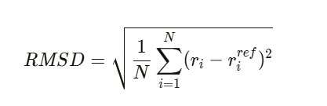
Stability of Simulated system: RMSD Analysis
It is a measure used to compare how similar or different two structures are. In Molecular simulations, it tells us about how much a molecular structure of a molecule (like protein) has moved or changed from it’s initial structure.
Replica 1
Replica 2
Systems appear to have reached equilibrium during the last 500 ns of the trajectory.
RMSD of glycosylated systems is less compared
to the non-glycosylated
.
11

Slide 12


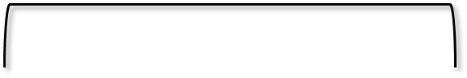
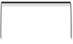

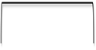
RESIDUE LEVEL DYNAMICS
RMSF is a measures of how much each atom or residue in a molecular structure moves or fluctuates during a simulation.
Replica 1
Replica 2
The reduced fluctuations could be caused by O-glycans’ present in the hinge region.
Membrane Proximal Domain
Cytosolic Tail
Membrane Proximal Domain
Cytosolic Tail
Trans-membrane Domain
Membrane Distal Domain
Trans-membrane Domain
Membrane Distal Domain
Hinge
Hinge
The reduced fluctuations could be caused by O-glycans’ present in the hinge region.
12

Slide 13
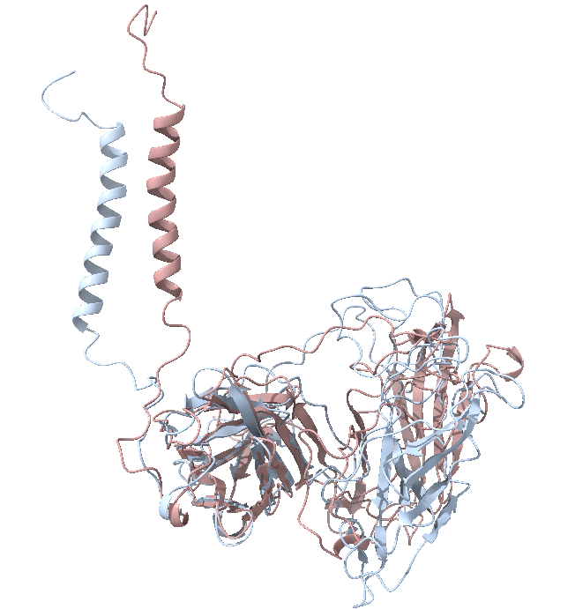
RESIDUE LEVEL DYNAMICS
It measures how spread out the molecule’s atoms are around its center of mass.
Replica 1
Replica 2
Non-Glycosylated
LAMP2A
Glycosylated
LAMP2A
Variations in the glycosylated system can be attributed to changes in the relative
orientation
13

Slide 14
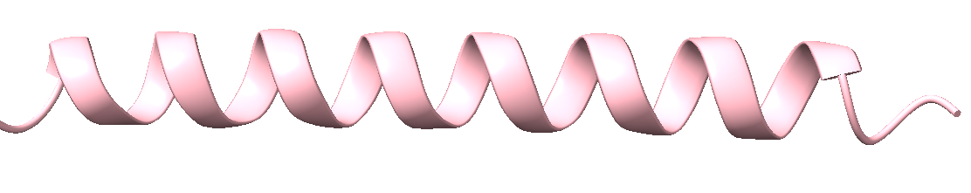
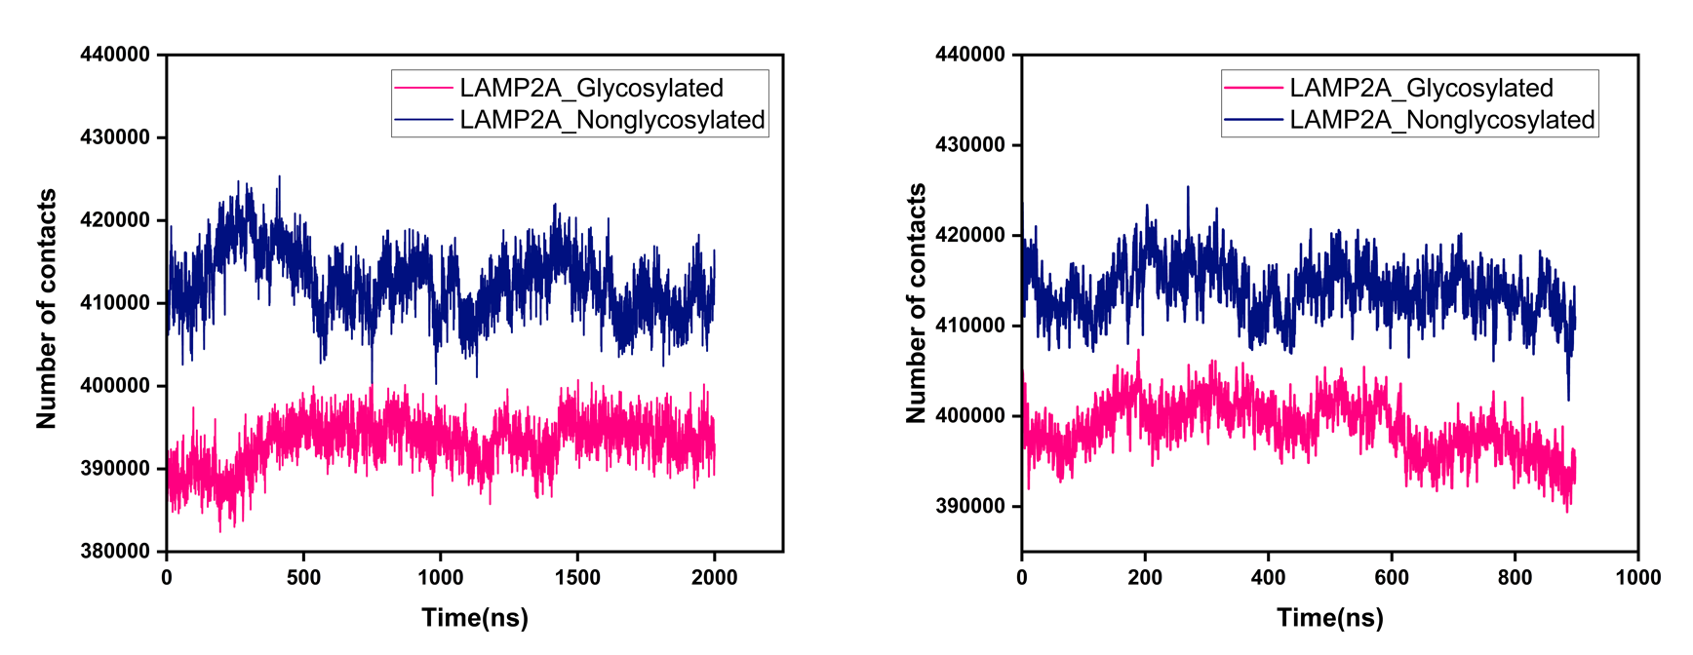
INTRA-PROTEIN CONTACTS
Intra-protein contacts refer to the interactions or close associations between different parts of the same protein molecule.
Contacts
Replica 1
Replica 2
Non-glycosylated system shows more intra protein contacts

Slide 15
MEMBRANE DENSITY
Lipid bilayer density refers to the mass of lipids and associated molecules per unit area or volume of the membrane. It quantitatively measures the compactness and molecular arrangement within the bilayer, reflecting the influence of lipid composition, packing, and membrane environment.
Replica 1
Replica 2
Peaks indicate the presence of headgroups and cholesterol near the bilayer surface. Valleys indicate the hydrophobic core of the membrane.
15

Slide 16
CONCLUSION AND FUTURE PLANS
Conclusion:
Modeled the complete glycosylated LAMP2A in a biologically relevant lysosomal membrane environment.
Few structural and dynamical changes, including enhanced radius of gyration and reduced conformational dynamics were observed in the glycosylated protein.
Future Plans:
Extensive analysis to explore the effect of glycosylation on LAMP2A.
Analyze how glycosylation affects the structural stability and conformational dynamics of LAMP2A
Explore the allosteric effects in protein as a result of glycosylation (if any).
16

Slide 17


ACKNOWLEDGMENT
Supervisior : Dr.Nidhi Malhotra
PG Advisor : Dr. Animesh Samanta
HOD : Prof.Bimlesh Lochab
Dean :Prof.Sanjeev Galanda
VC :Prof. Ananya Mukherjee
All the faculty members and staff
My labmates : Ishwar,Devid and Joytika
All my friends,seniors and juniors
17

Slide 18
Thank you !!

